Slide 1
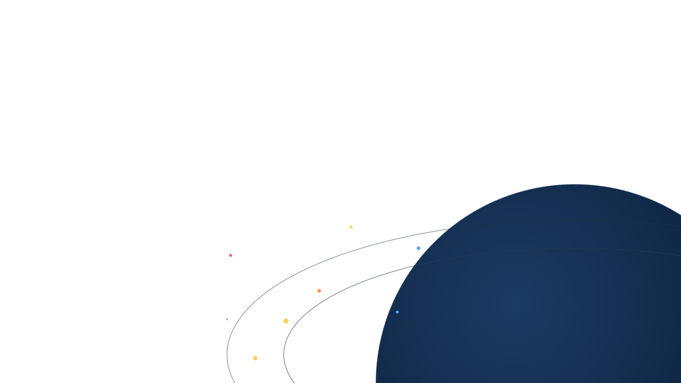
ORBITAL DEBRIS STUDY
A Barrel of Nails
in Low-Earth Orbit
The cheapest, lowest-tech debris weapon imaginable: no guidance, no interceptor — just mass and a dispenser. Could it trigger Kessler syndrome and render LEO unusable? We answer with numbers, and weigh it against what really fills orbit.
Real catalog · CUDA propagation · NASA breakup model · three cascade engines

Slide 2
THE DEBATE
Two loud claims — both wrong
Why ask: a barrel is the cheapest way to put a debris weapon in orbit — no guidance, no interceptor, just mass and a dispenser. It deserves a number, not an opinion.
CLAIM A — FALSE
CLAIM B — FALSE
“It will do no harm”
“It renders LEO unusable”
Every nail is a lethal, satellite-killing projectile, and a barrel adds a persistent debris population. Harmless it is not.
One barrel never triggers a runaway. Low down, drag clears it in a couple of years; at 900 km, no number of barrels doubles the ≥10 cm belt.
The truth is quantitative — it depends almost entirely on altitude, and it only means something when compared with ordinary traffic.

Slide 3

THE SCENARIO
One barrel of nails, defined
The projectile
The deployment
Steel nail | 75 × 3 mm
Mass each | 4.16 g
Tumbling cross-section | 1.8 cm²
Count in a barrel | 200,000
Total launched mass | 832 kg
Released as a random dump — each nail gets a small random Δv, no targeting. The least-hostile way to spread a barrel.
Placed at a chosen altitude and inclination (default 550 km / 53°), then set loose in the real catalog + a modelled 1–10 cm debris field.
Measured: single-nail lethality · drag lifetime · collision flux · a 50-year cascade in three engines · usability by altitude.

Slide 4
GROUNDED IN REAL DATA
The catalog we simulate
29,779
9,956
REAL OBJECTS · RADAR CROSS-SECTION
Object | RCS | Altitude
ISS (Zarya) | 399 m² | 416 km
Hubble | 28 m² | 470 km
Envisat · 8 t, dead | 19 m² | 761 km
SL-16 rocket body | 11 m² | ~850 km
tracked objects in LEO
catalogued debris pieces (+1,573 rocket bodies)
511 kg
4.4 m²
mean payload mass
mean payload cross-section
The environment: every catalogued object carries its own mass and area, from its radar cross-section where known (97%), alongside a modelled field of ~1,000,000 lethal 1–10 cm fragments too small for radar to track.

Slide 5
KEY TERMS
The vocabulary
Kessler syndrome / runaway
Supercritical
Catastrophic collision
A chain reaction: each collision makes debris that triggers more collisions, so the debris count keeps climbing on its own — even if every launch stopped today.
The tipping condition behind runaway: in a shell, collisions make fragments faster than drag removes them, so the population grows unaided.
An impact carrying ≥ 40 joules per gram of the target's mass — enough to shatter it, not just crater it.
NASA Standard Breakup Model
The belt (700–1,100 km)
≥10 cm objects
The standard empirical formula (Johnson et al., 2001) for how many fragments of each size a collision or explosion makes, from the objects' mass. Fit to real on-orbit events.
Where drag is weak and today's debris belt lives. The results track how its population changes over 50 years.
Big enough to track by radar and to shatter a small satellite — the standard metric of debris-evolution studies.
RCS (radar cross-section)
A/m & drag lifetime
Mission-kill
How big an object looks to tracking radar (m²) — used as its collision cross-section and to estimate mass.
Area-to-mass ratio sets how fast drag lowers an orbit: low orbits self-clean in years, high orbits persist for centuries.
An impact that disables a satellite without shattering it — leaving a dead hulk plus a little cratering debris.

Slide 6





THE TOOL
One question, a full modelling chain
Real catalog
CUDA propagation
Breakup model
Cascade engines
CelesTrak + Space-Track, per-object mass & RCS
J2 orbits on an RTX 5090, 177 M states/s
NASA Standard Breakup Model, 40 J/g threshold
Box ODE · discrete MC · conjunction geometry
Three independent engines, plus launch traffic, explosions, debris removal and an “operators retreat” feedback. The cube engine draws the scenario charts; the box model resolves the barrel-sized effects; the discrete engine checks both.

Slide 7
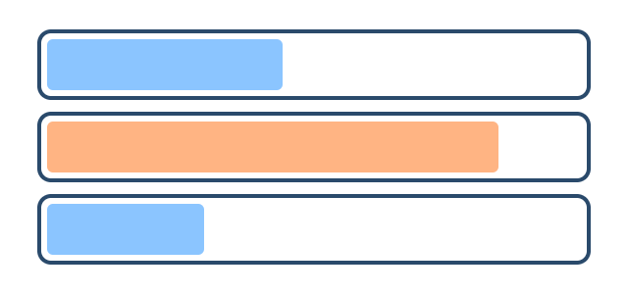
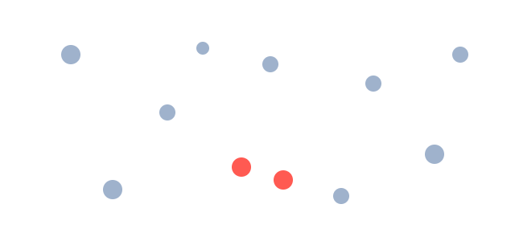
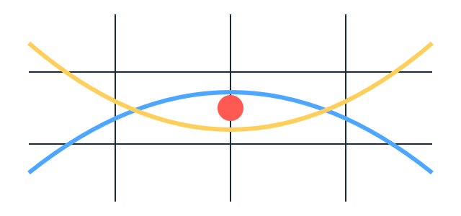
THE ENGINES
Three ways to model a cascade
Box · source–sink ODE
Discrete · super-particle MC
Conjunction · cube method
fast · aggregate
mid · per-object
high · real geometry (GPU)
Debris counts per altitude shell and size class, evolved by one equation. Well-mixed, no individuals.
Every object is an individual; collisions are drawn statistically, and fragments get real orbits that spread across shells.
Every object propagated on the GPU; a collision happens only where two orbits actually cross the same small cube.
Role: barrel-sized effects; cross-check.
Role: cross-check (8-seed ensembles).
Role: scenario charts (16-seed ensembles).

Slide 8
THE PHYSICS
A single nail: lethal, but no satellite-destroyer
Impact @ 10 km/s | Energy | Catastrophic? | Result
4 g nail → 260 kg sat | 208 kJ | No · 0.8 J/g | Mission-kill + ~130 frags
4 g nail → 3 kg cubesat | 208 kJ | Yes · 69 J/g | Shattered · ~600 frags
260 kg → 260 kg sat | 13 GJ | Yes, deeply | ~29,000 frags
40 J/g
the catastrophic-fragmentation line. A nail against a Starlink lands at 0.8 J/g — 50× too low.
A nail mission-kills whatever it hits, but to shatter a 260 kg satellite you'd need a ~200 g bolt, not a nail. The huge fragment clouds come from large-on-large collisions.

Slide 9
01
Nails mission-kill satellites, leaving dead hulks and cratering debris behind.
THE CASCADE
Accelerant,
not igniter
02
That extra mass raises the standing density in the shell.
A barrel can't start Kessler by itself — nails are too light to shatter big objects. What it does is slightly raise the odds of the large-on-large collisions that already drive the belt.
03
But the push is weak: no number of barrels adds more than ~25% to the ≥10 cm belt in 50 years.

Slide 10
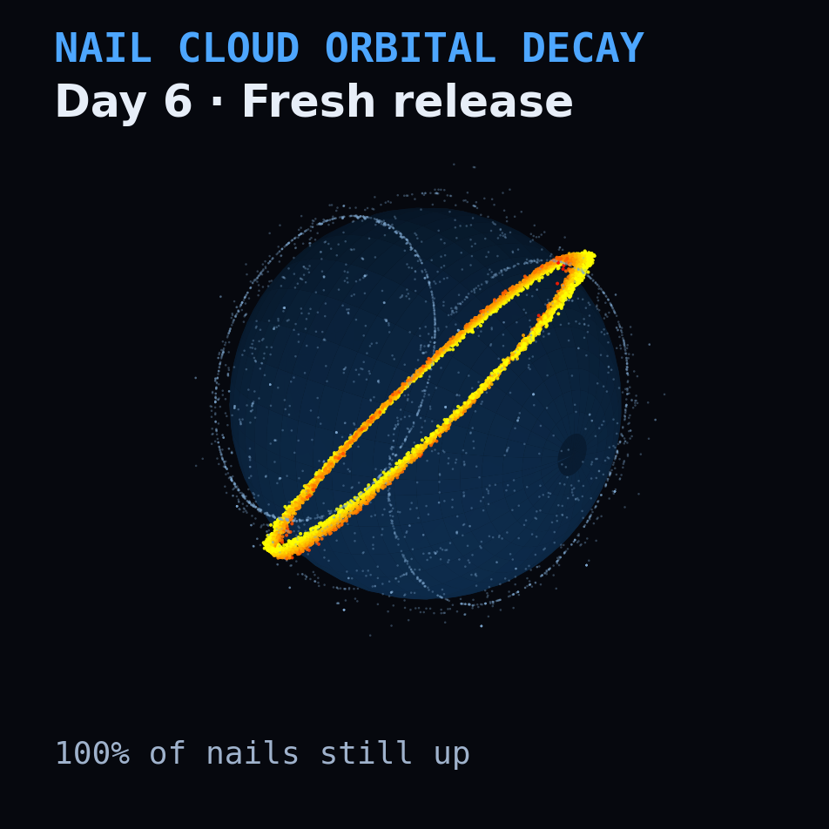
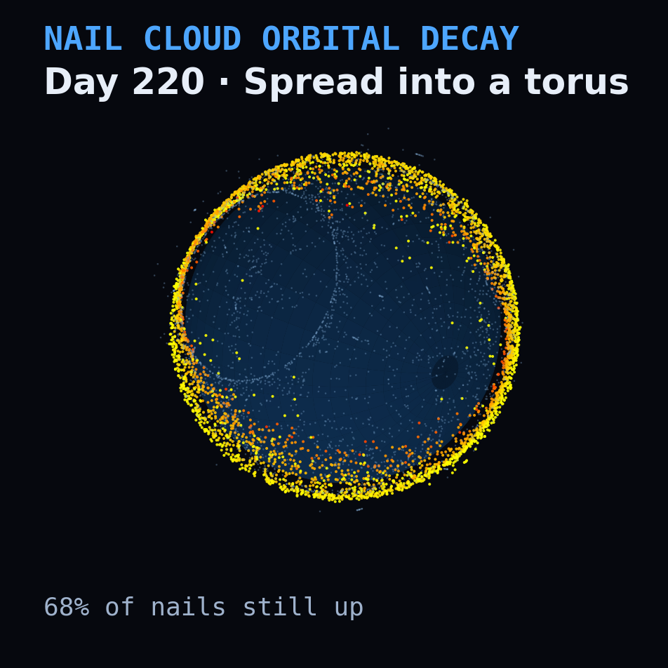
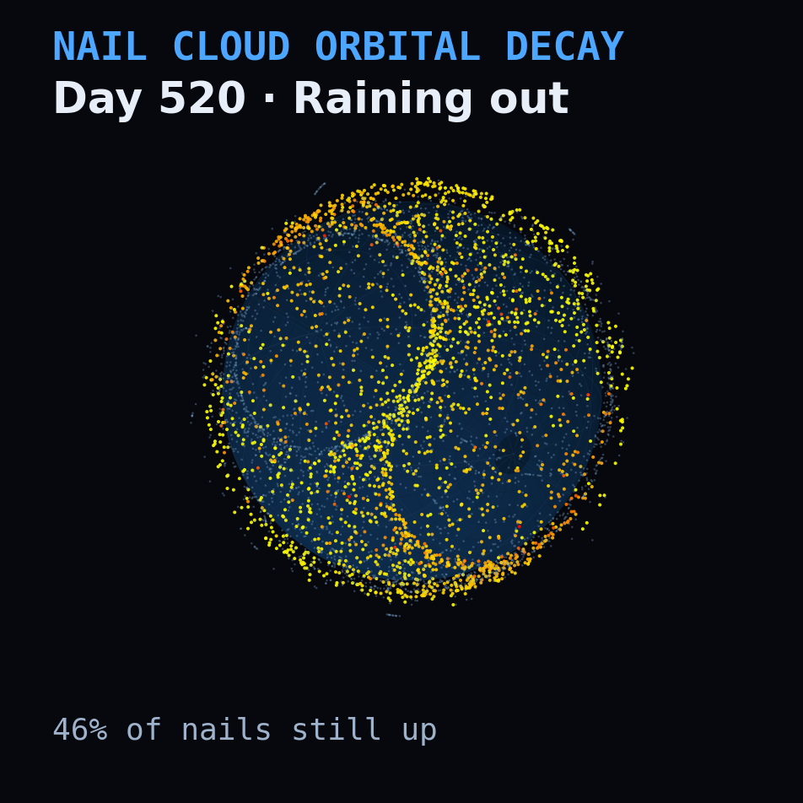
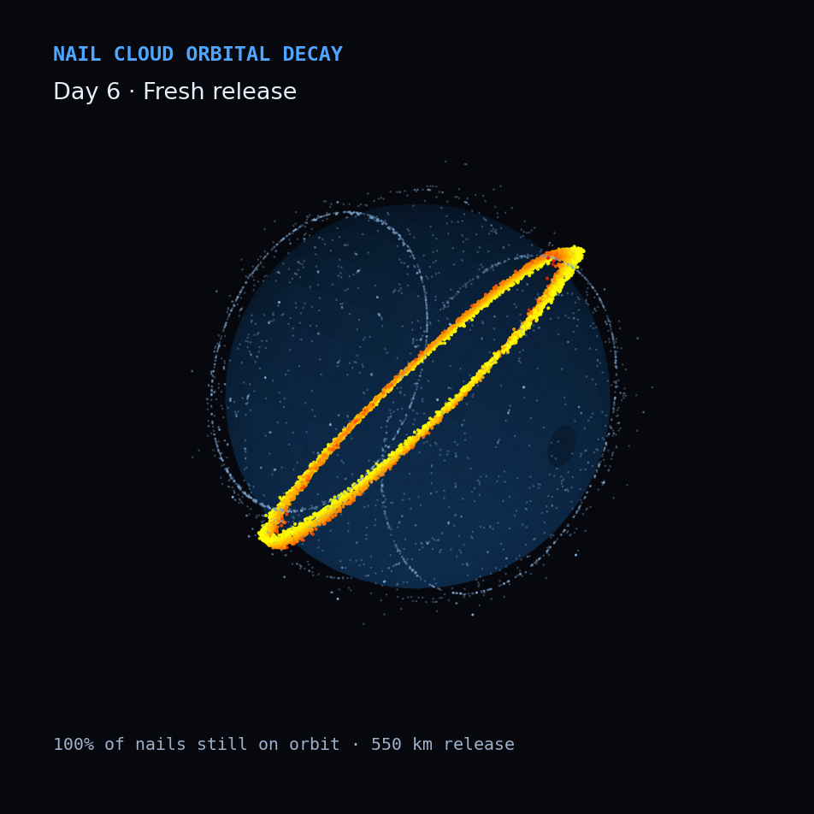
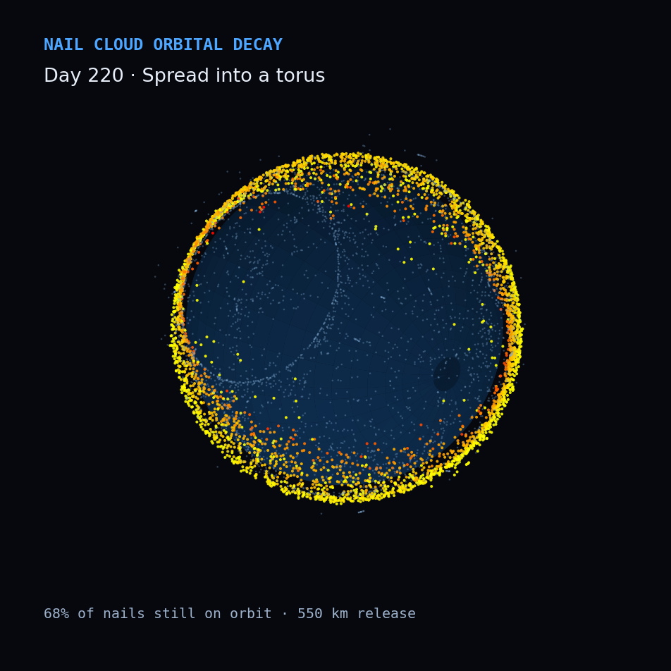
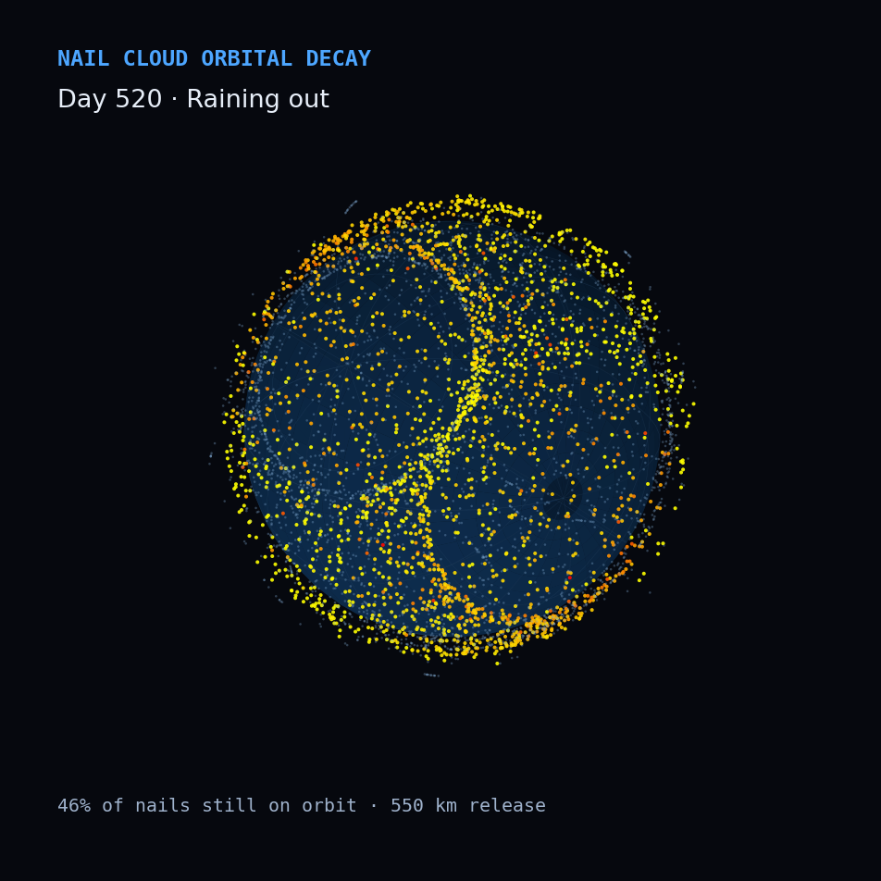
ORBIT VISUALIZATION
The nail cloud spreads, then rains out
Left → right: a tight ring at release, spread into a shell by differential precession, then decaying under atmospheric drag — ~46% remain after ~1.5 years at 550 km. Model output, 200,000 nails, J2 + drag.

Slide 11
THE SCALE CHECK
How many barrels to tip a band?
≤ +25%
90–230
≈ 22
any number of barrels, ≥10 cm belt
barrels double the 1–10 cm field
barrels ≈ one ASAT, ≥10 cm belt
Barrels dumped at 900 km, over 50 years, compared with the same run without them. Nails flood the lethal-but-untrackable 1–10 cm field but barely feed the ≥10 cm cascade: the belt reaches +21% above the no-barrel run at 300 barrels and +25% at 1,000 — flattening, never doubling. The 90–230 range brackets how much debris small impacts throw off (breakup model as written vs NASA's LEGEND convention).

Slide 12
THE FINDING
Altitude is the whole story
1,200–1,500 km
Secondary persistent zone — even small fragments stay for centuries to millennia, and it is exactly where several proposed mega-constellations intend to operate.
The “bad neighborhood.” Fragments last decades to a century, intact objects centuries — and the real debris belt lives here, home to dead giants like Envisat (8 t, 761 km). With no launches at all, its ≥10 cm population still grows ~19% in 50 years. NASA's LEGEND puts ~60% of future catastrophic collisions at 900–1,000 km (Liou & Johnson 2006).
700–1,100 km
200–600 km
Self-cleaning. Drag clears fragments in months to a few years and dead satellites in about a decade; a barrel at 550 km loses half its nails in 1.5 years.
LEO is not one place: low orbit self-heals, high orbit is nearly permanent. Risk scales dramatically with altitude.

Slide 13
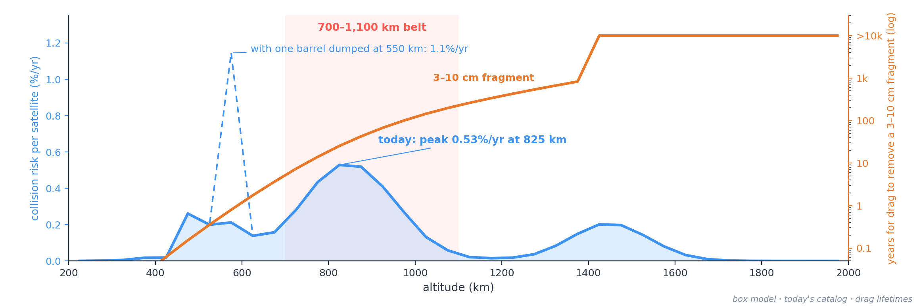
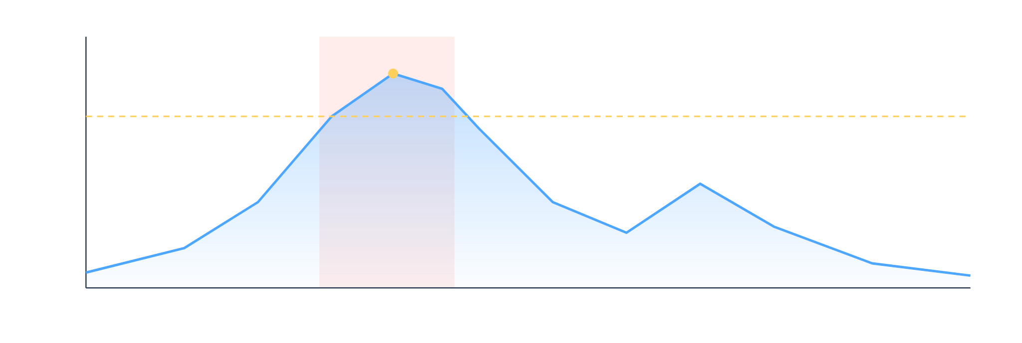
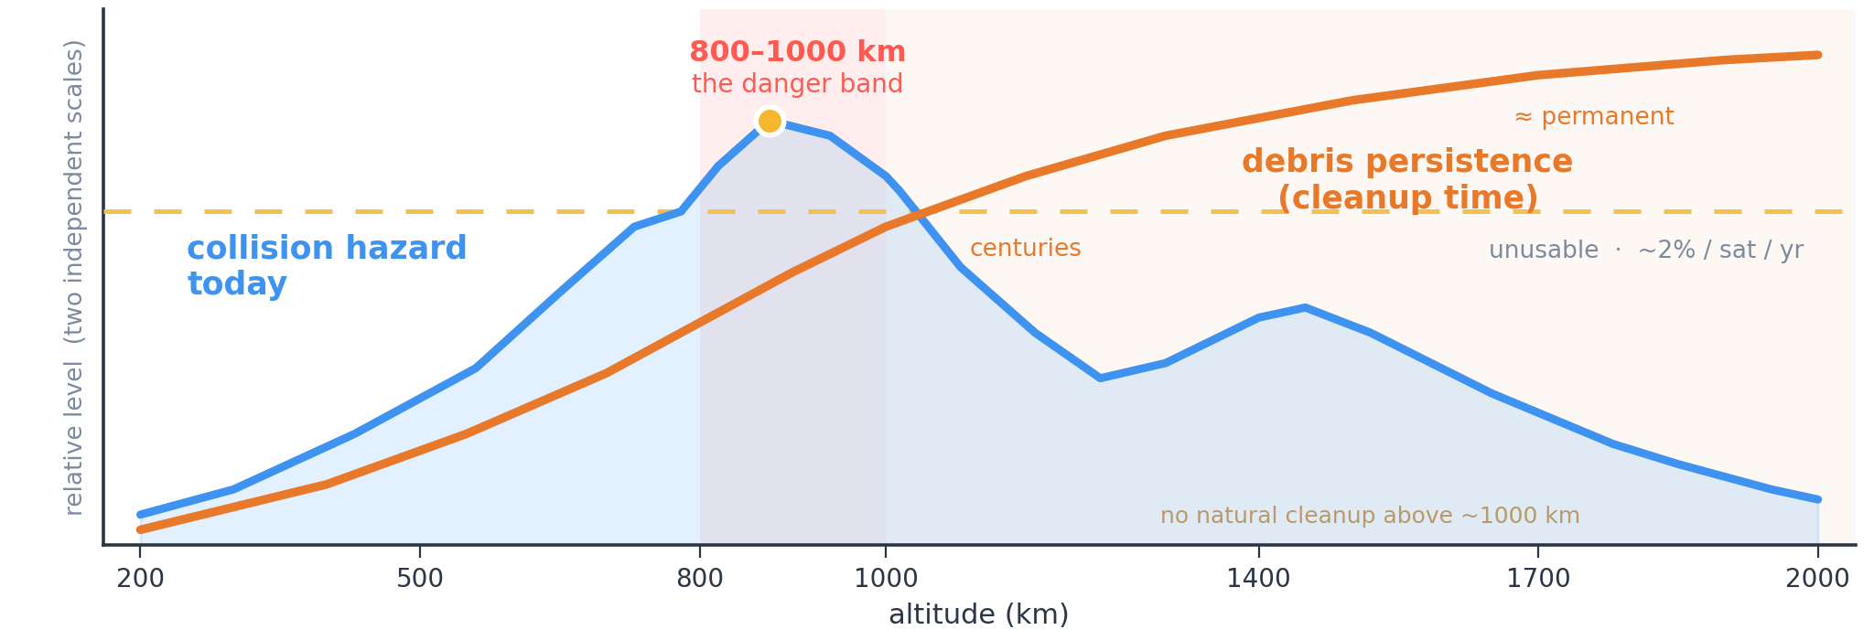
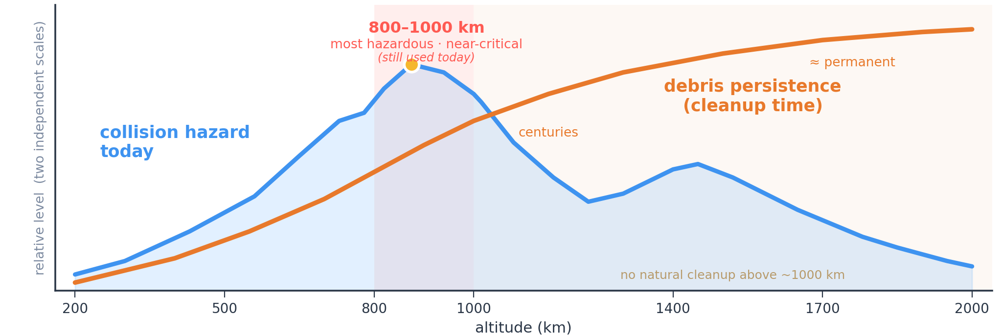
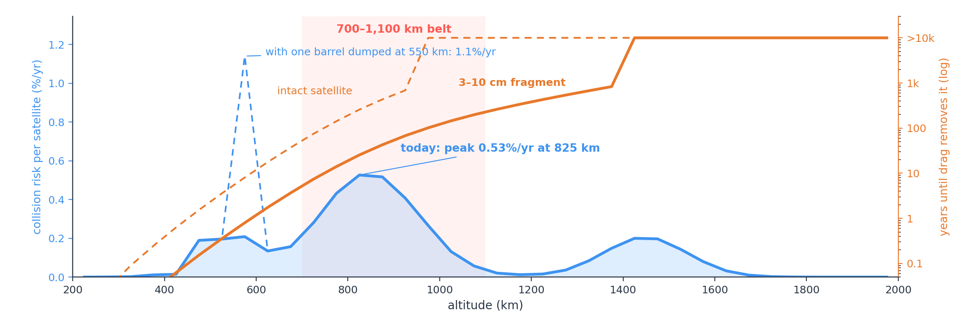

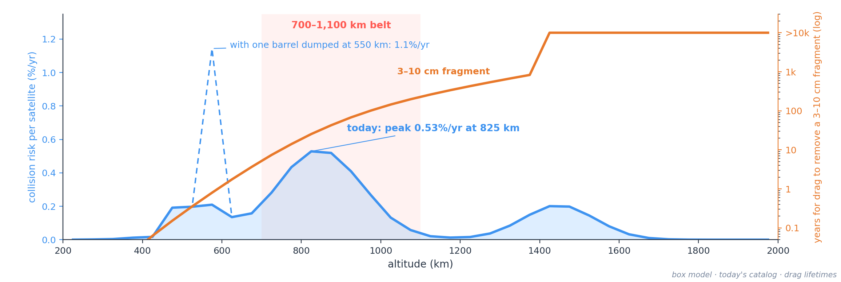
USABILITY BY ALTITUDE
Where the risk is — and how long it stays
Most hazardous — but not unusable.
A satellite in the 700–1,100 km belt runs a ~0.5% a year chance of a lethal hit today — the worst in LEO, but well below the ~2%/yr at which operators abandon a band. Orange is the deeper problem: above ~1,000 km even small fragments stay for centuries, so whatever breaks there doesn't clear. One barrel at 550 km briefly makes its shell the most dangerous in LEO (~1.1%/yr, 5× normal).

Slide 14
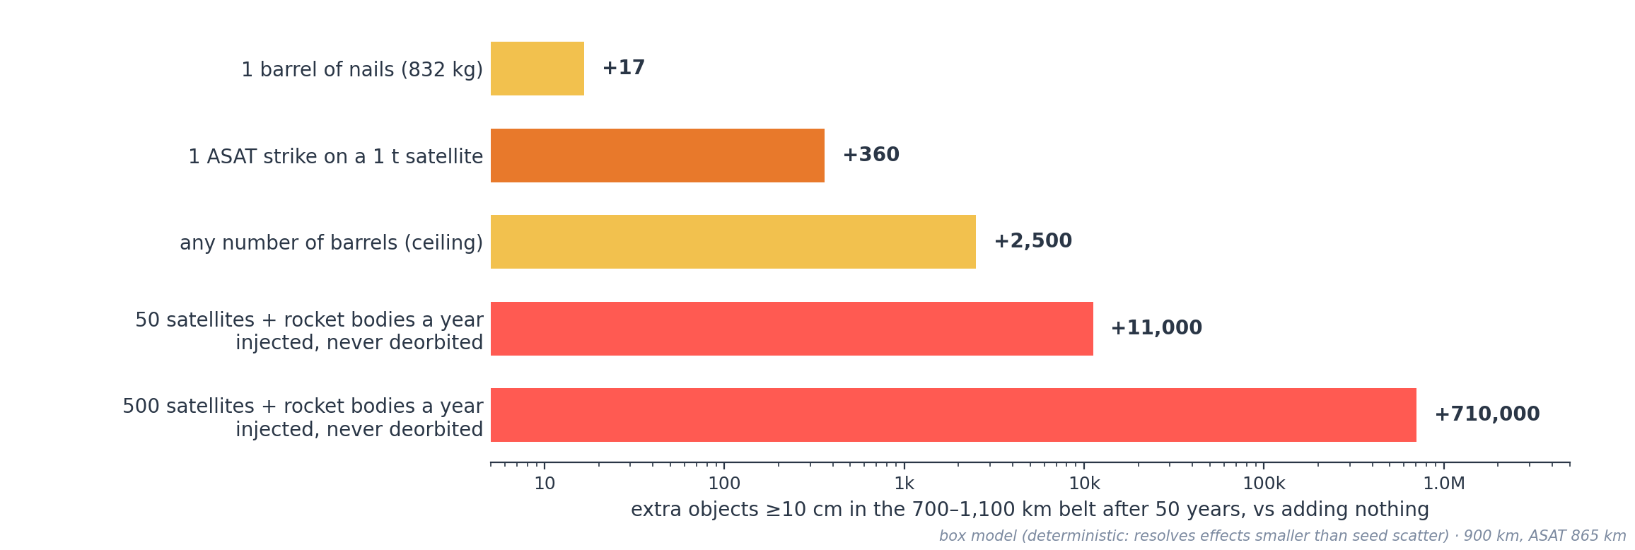

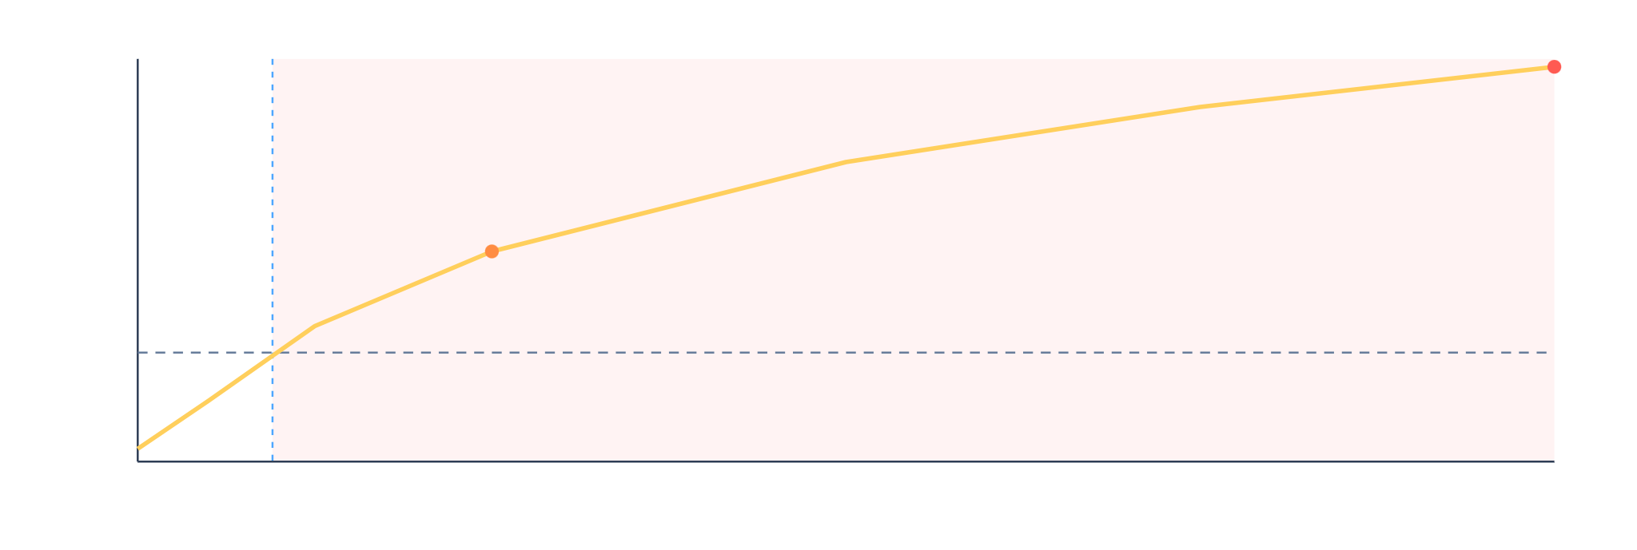
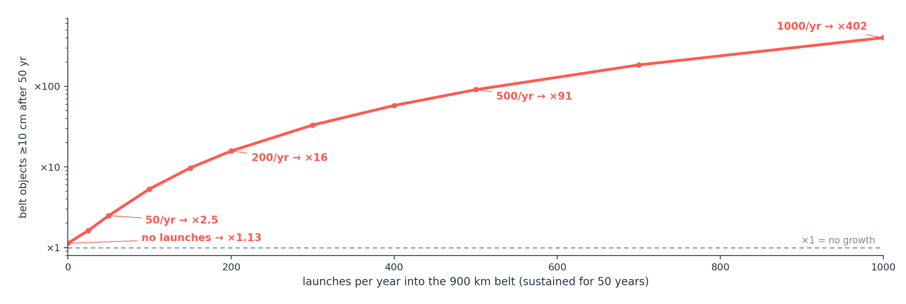
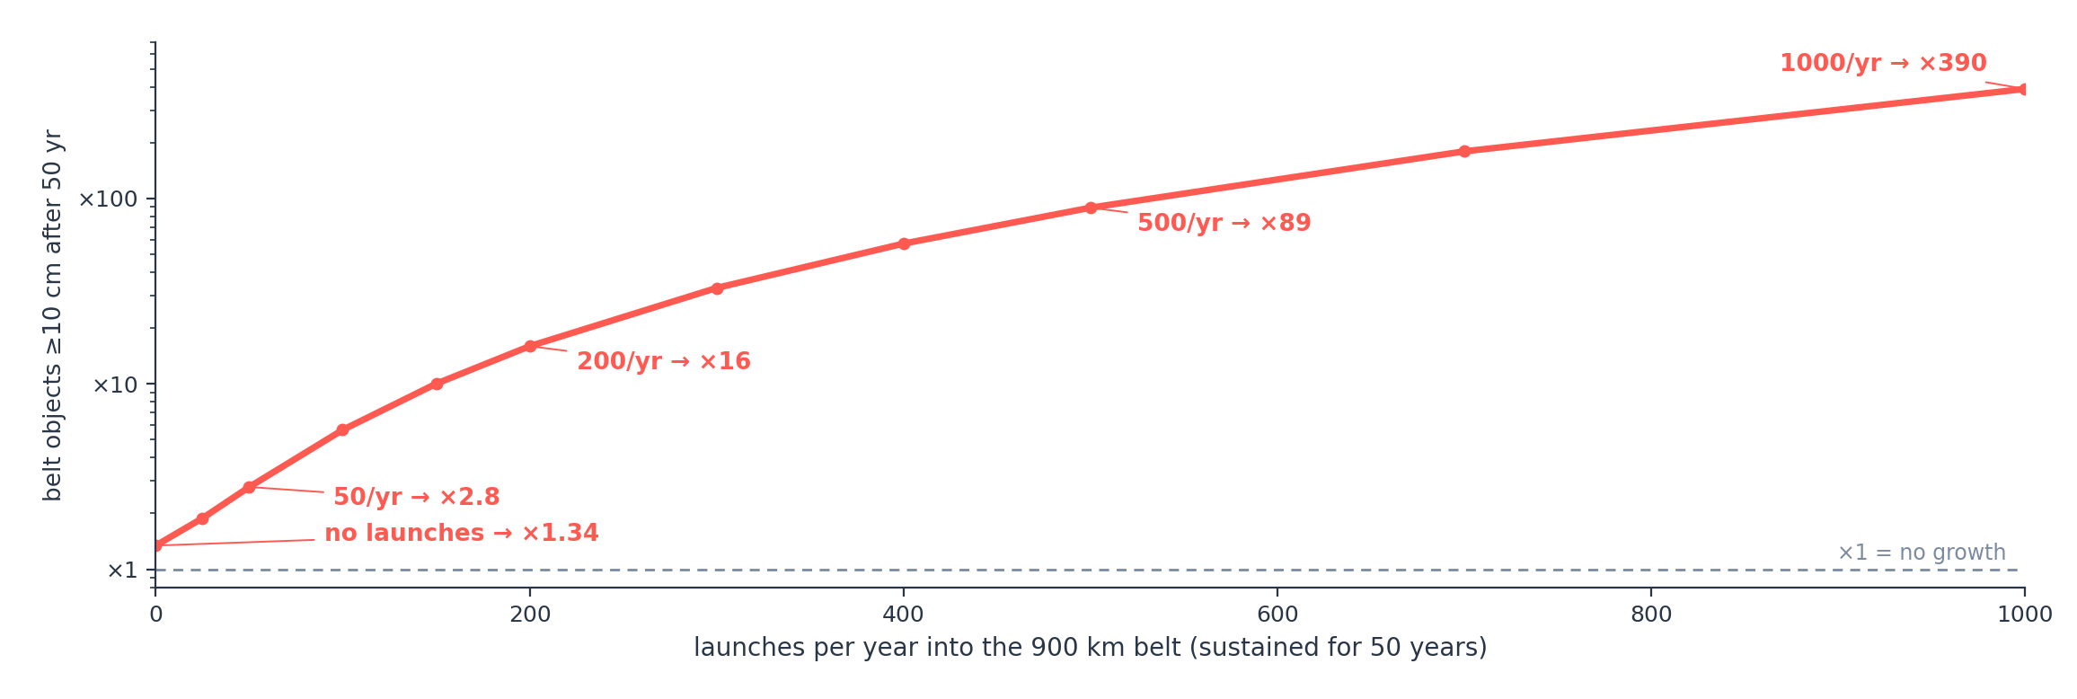
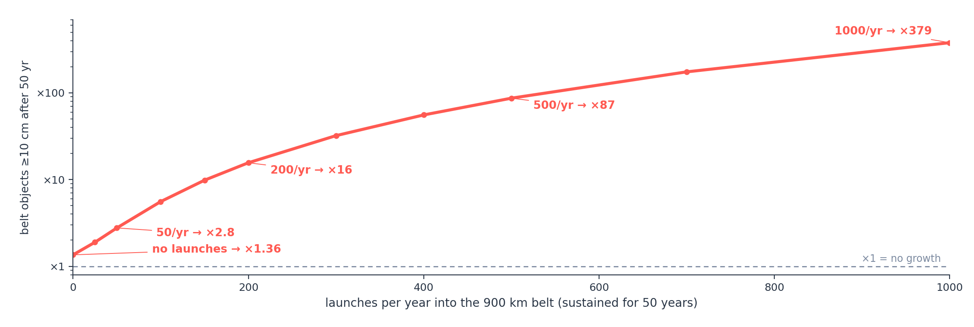
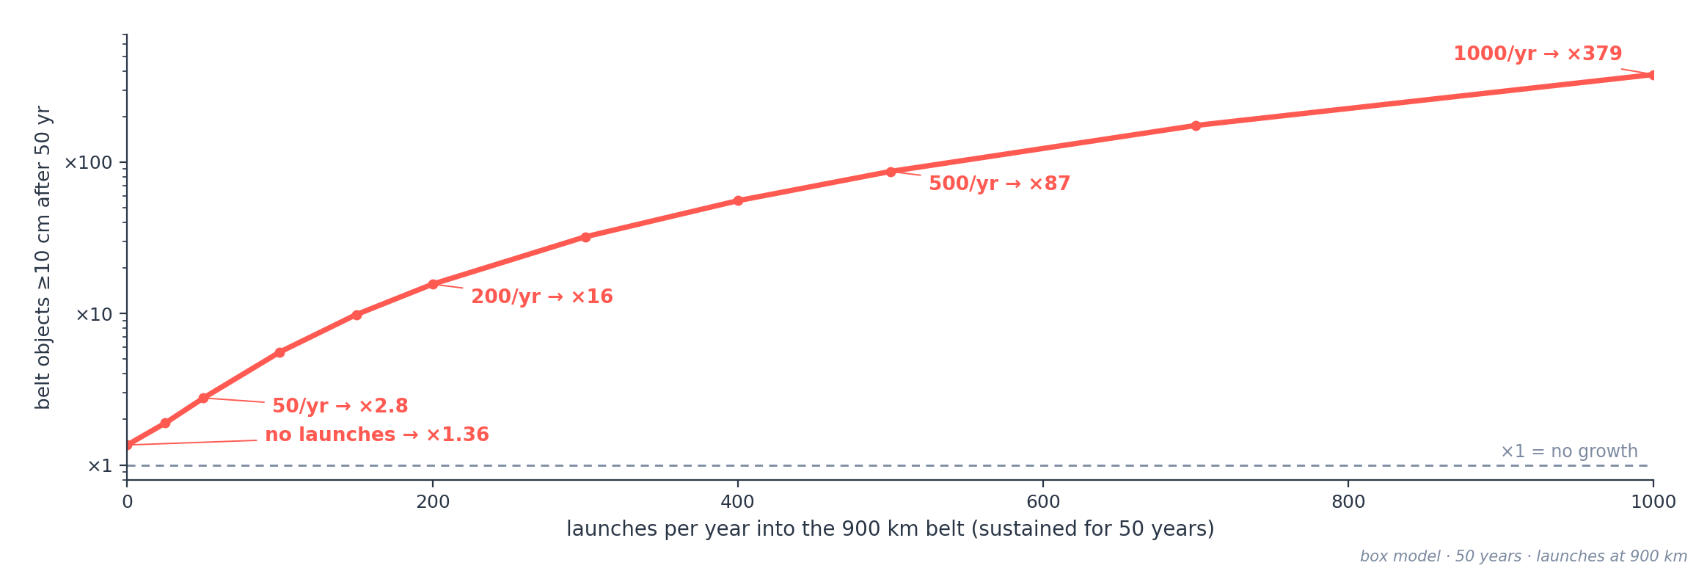
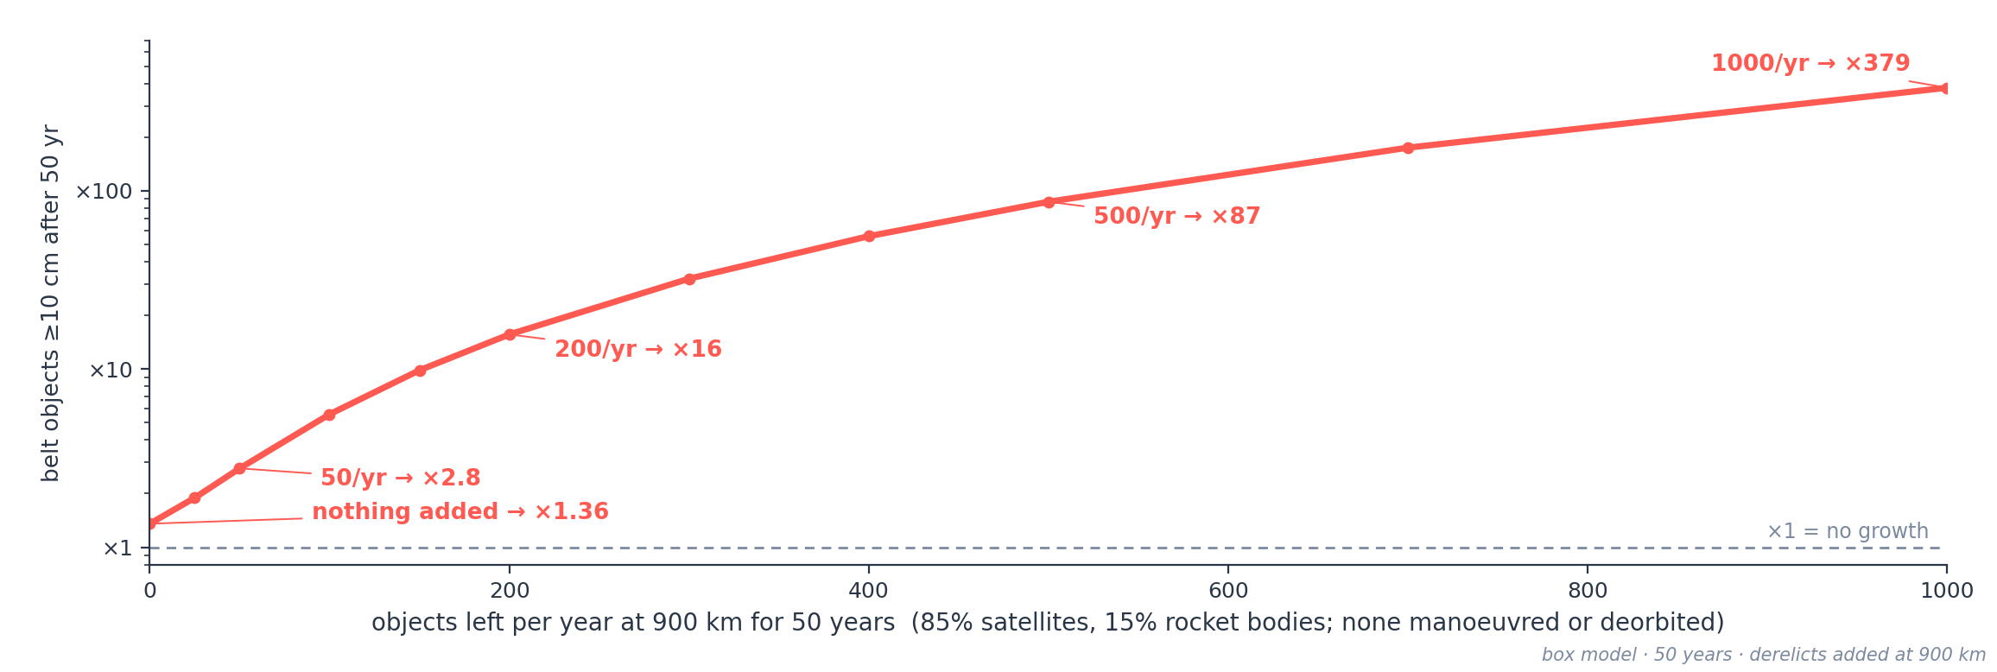
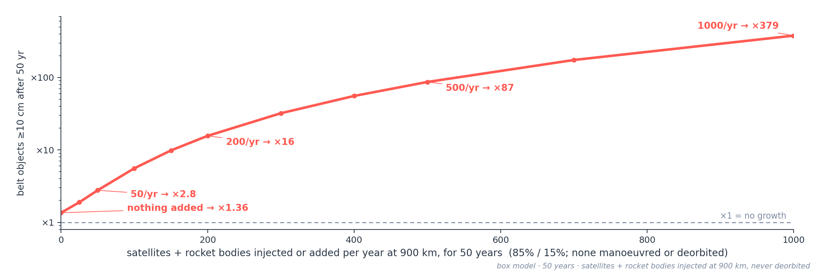
FOR COMPARISON
If not the barrel, what would?
Same measure = extra objects in the belt, for every source.
Extra ≥10 cm objects in the 700–1,100 km belt after 50 years, compared with adding nothing. One barrel adds ~17, an ASAT strike ~360, and no number of barrels more than ~2,500. Injecting 50 satellites and rocket bodies a year that are never deorbited adds ~11,000 — 4.5× the barrels' ceiling. Traffic, not the barrel, is what moves the belt — the next slides show how far.

Slide 15
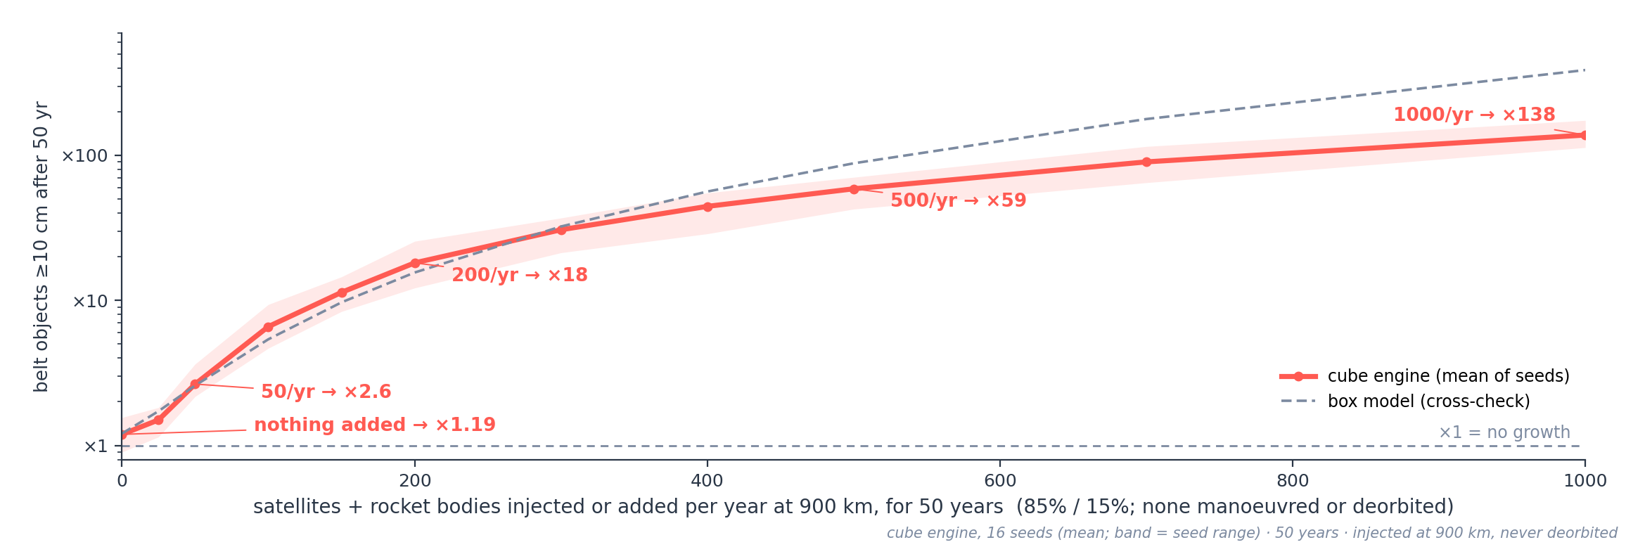
FOR COMPARISON · THE TIPPING POINT
Injected satellites and rocket bodies drive the belt
Runaway = the debris population grows without ever settling.
Collisions and explosions breed fragments faster than drag can remove them, so more debris drives more collisions — a self-feeding cascade (Kessler syndrome). The belt is already there: with nothing added, its ≥10 cm population grows ~19% in 50 years. Each satellite or rocket body injected or added to it steepens that: 50 a year ×2.6, 200 a year ×18. None is ever manoeuvred or deorbited, and all sit at 900 km — a stress test, not a traffic forecast. Cube engine, mean of 16 seeds; cross-check at 50/yr: box ×2.6, discrete ×2.0 (8 seeds) — same story.

Slide 16
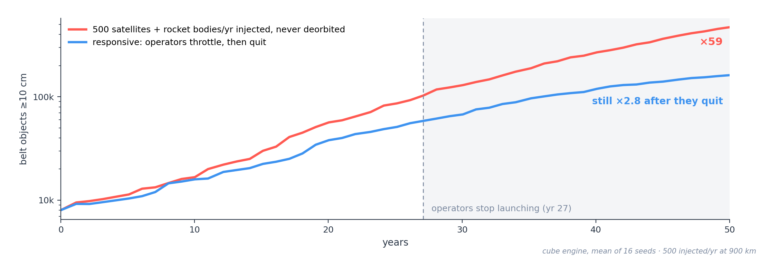
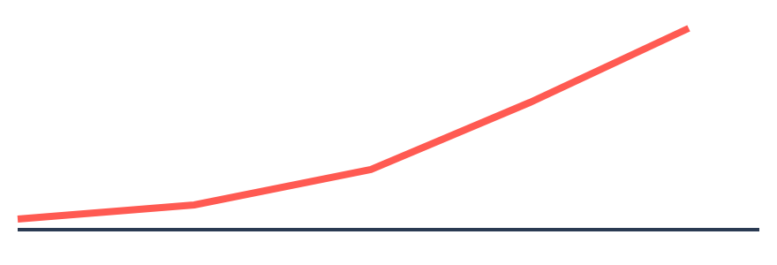
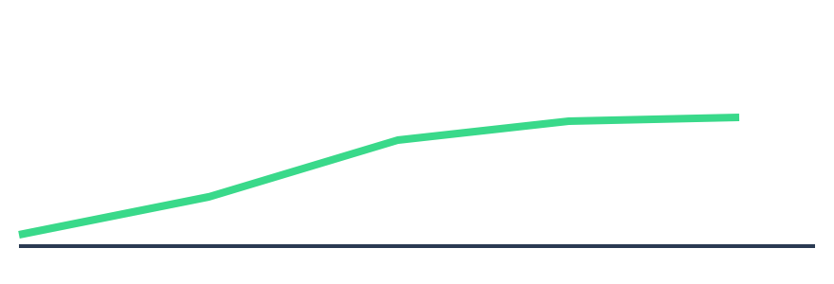
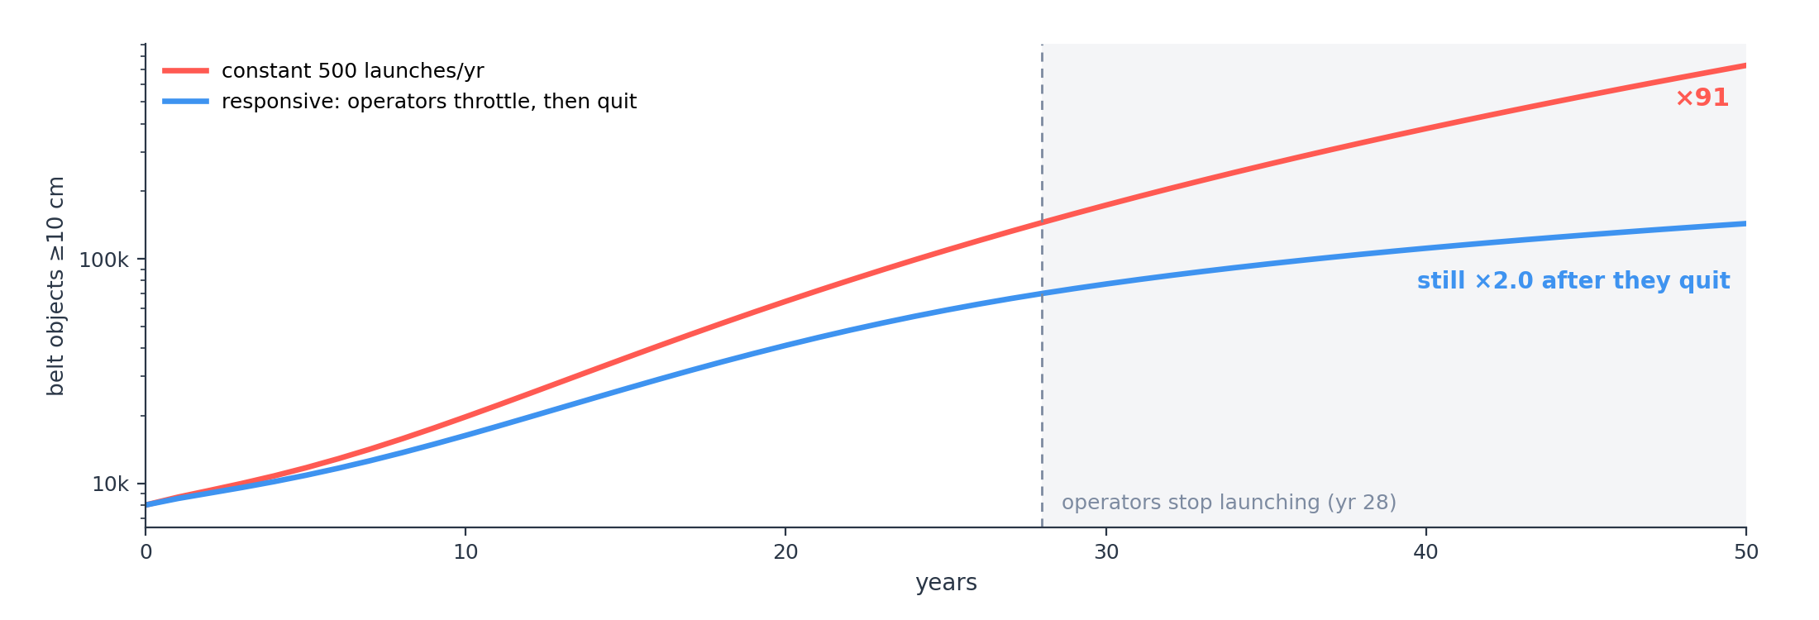


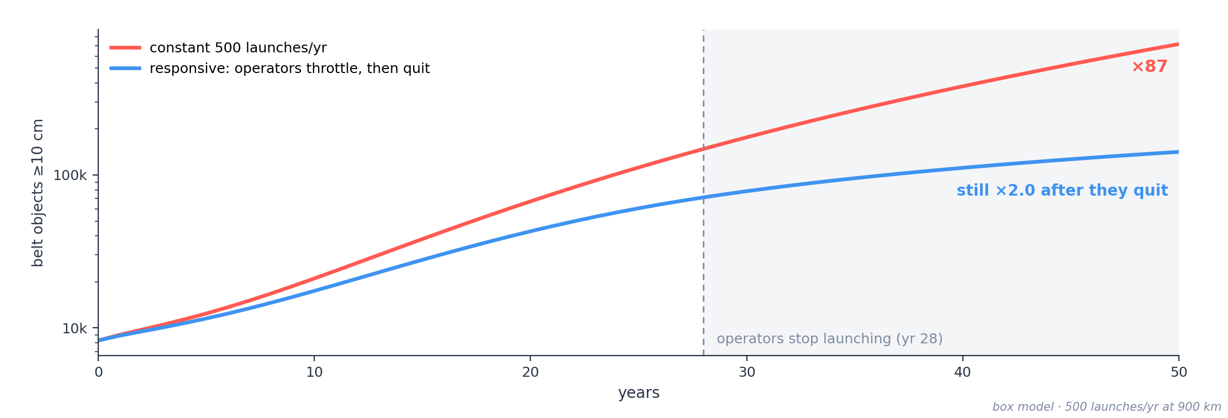
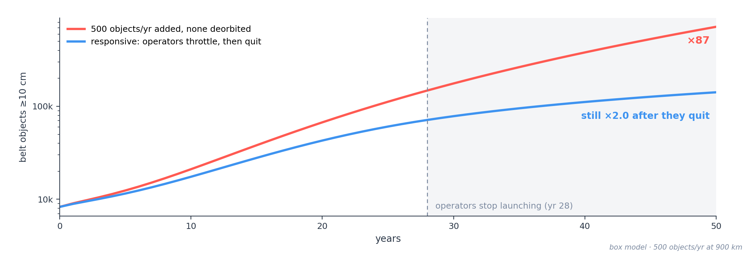
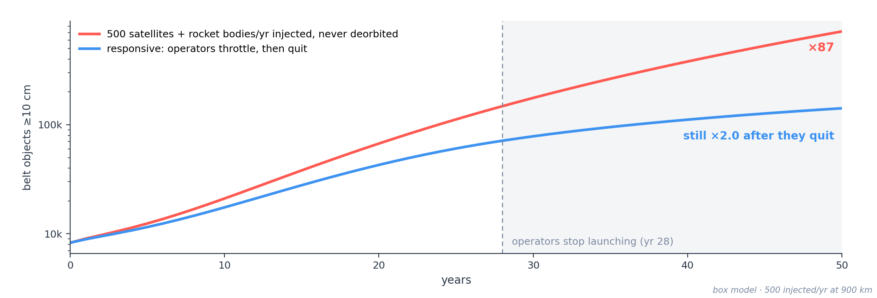
FOR COMPARISON · RATIONAL OPERATORS
Operators quit — the cascade doesn't
With 500 satellites and rocket bodies a year injected into the belt (none ever deorbited), operators throttle back as the risk rises and stop entirely by year ~27 — yet the belt's ≥10 cm population still grows ×2.8 afterwards. Abandoning a band doesn't save it once the cascade runs.

Slide 17
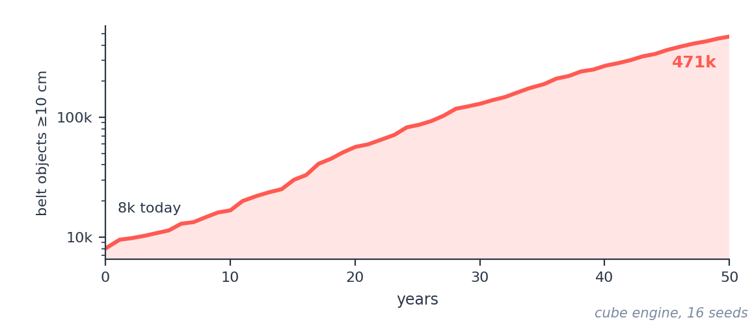
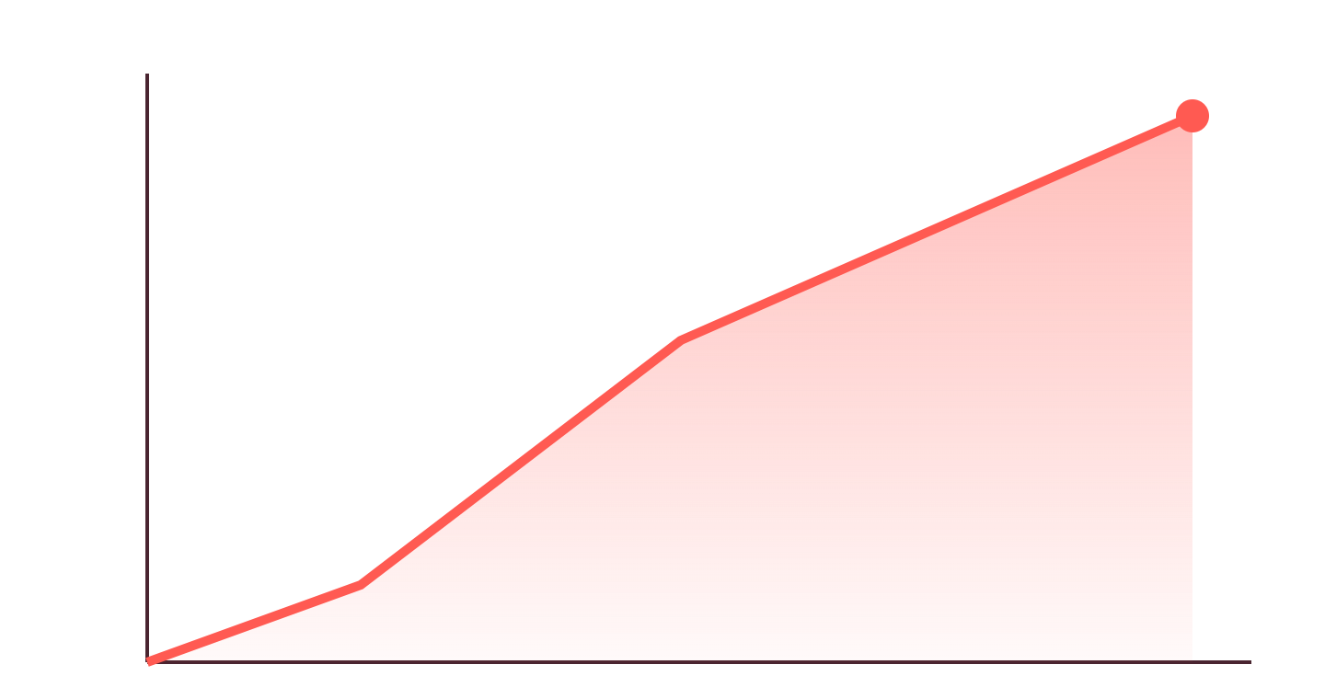
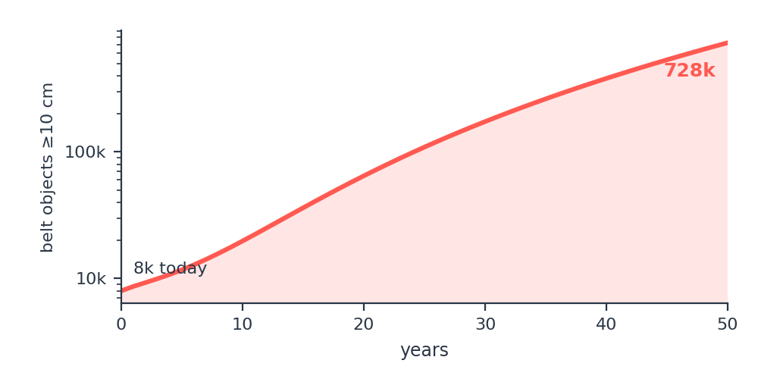
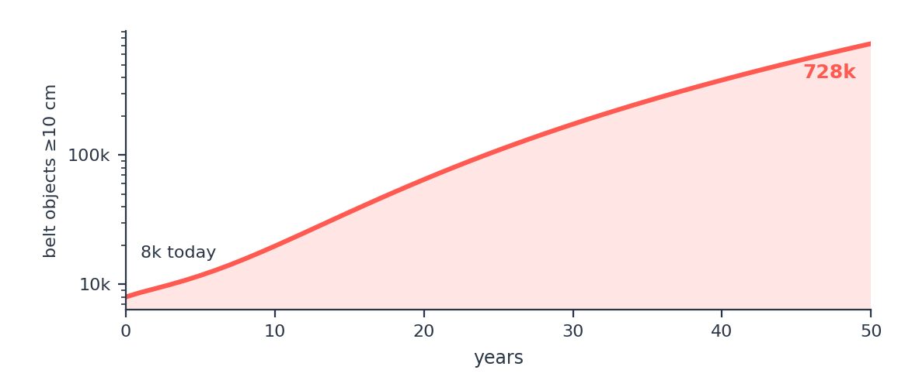
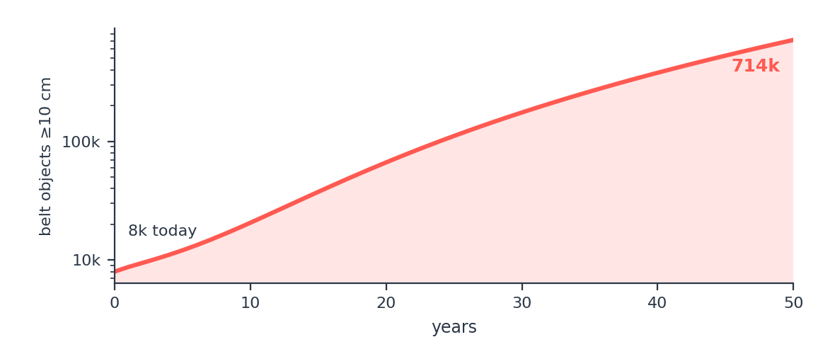

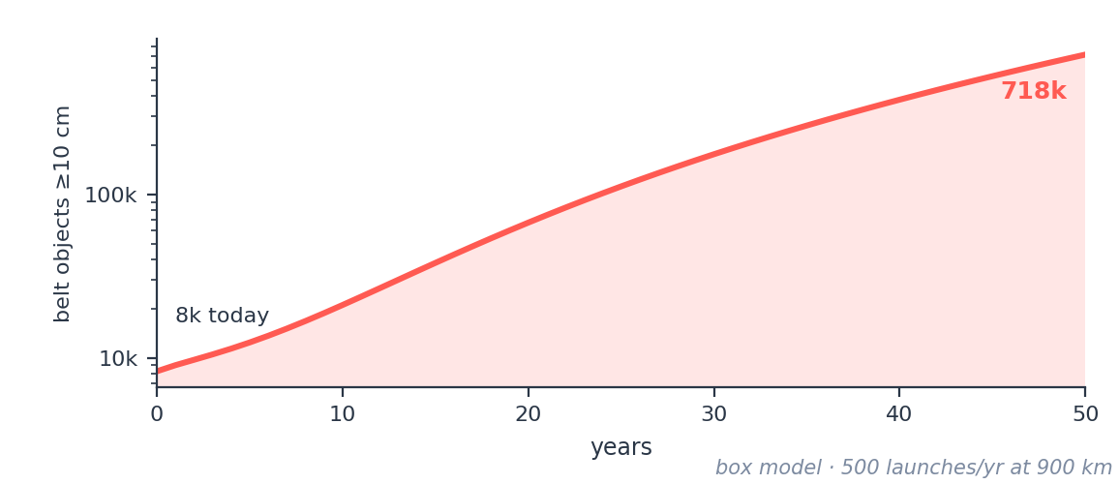
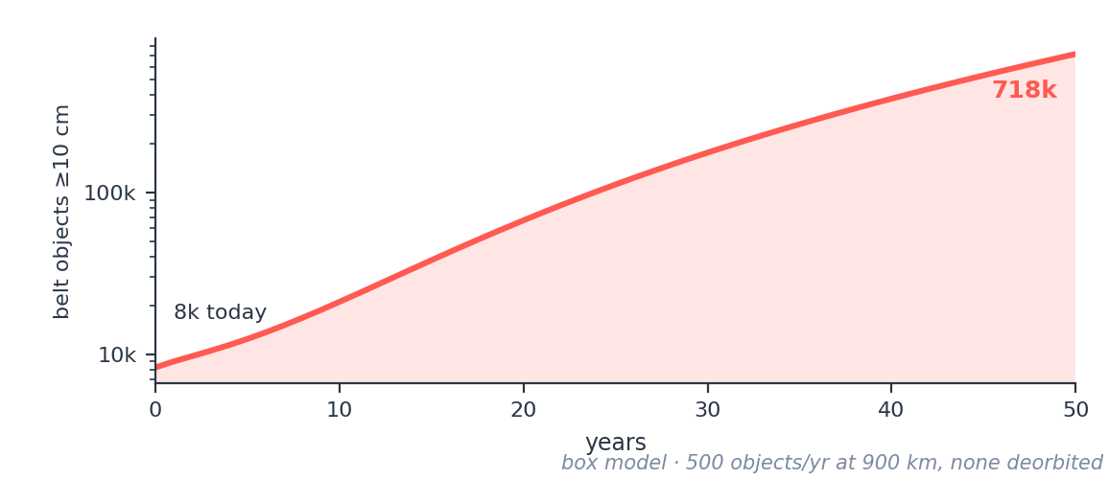
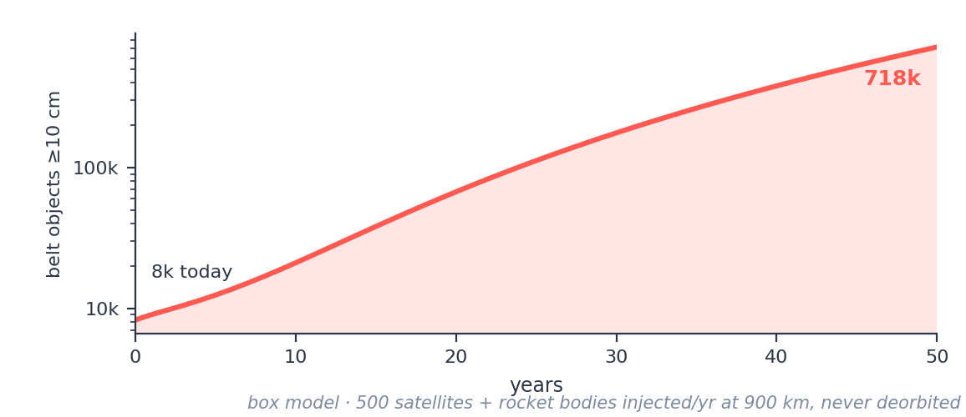
FOR COMPARISON · THE EXTREME CASE
What it would actually take to break LEO
Objects ≥10 cm in the 700–1,100 km belt, 50 years
~350 / yr
catastrophic collisions by year 50, incl. 1–10 cm impactors
×59
growth in objects ≥10 cm (8k → 471k)
Trigger: ~425 satellites + 75 rocket bodies injected a year for 50 years, never deorbited. No ASAT.
It takes mass and catastrophic energy — large objects, not nails. One ASAT strike on a 1 t satellite makes ~50,000 fragments ≥1 cm; the extreme is 500 satellites and rocket bodies a year piling into a band that already grows on its own. A nail has neither the mass nor the energy. Adding a barrel on top changes the belt by under 0.1%. The collision count includes 1–10 cm fragments shattering small objects, which NASA's LEGEND model leaves out: it counts ≥10 cm objects only.

Slide 18
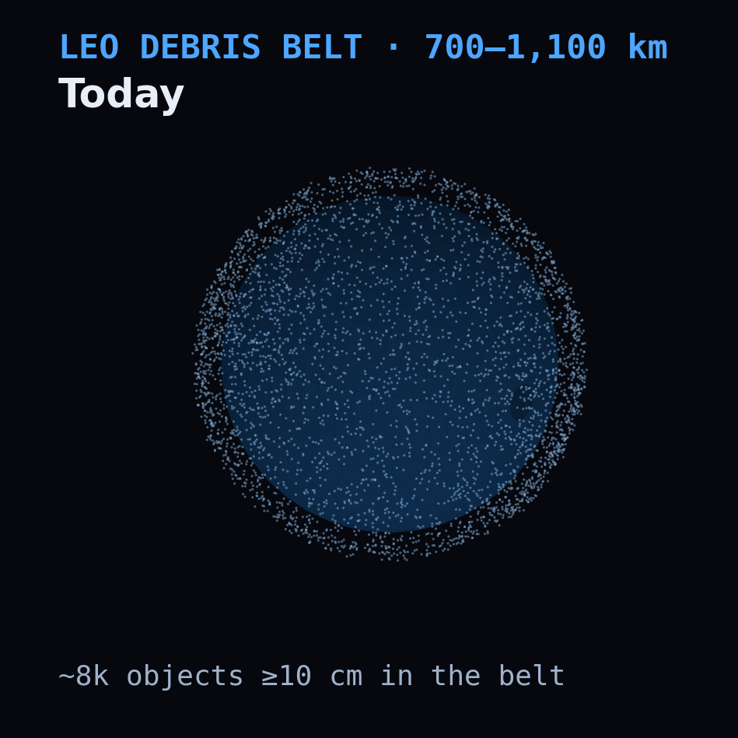
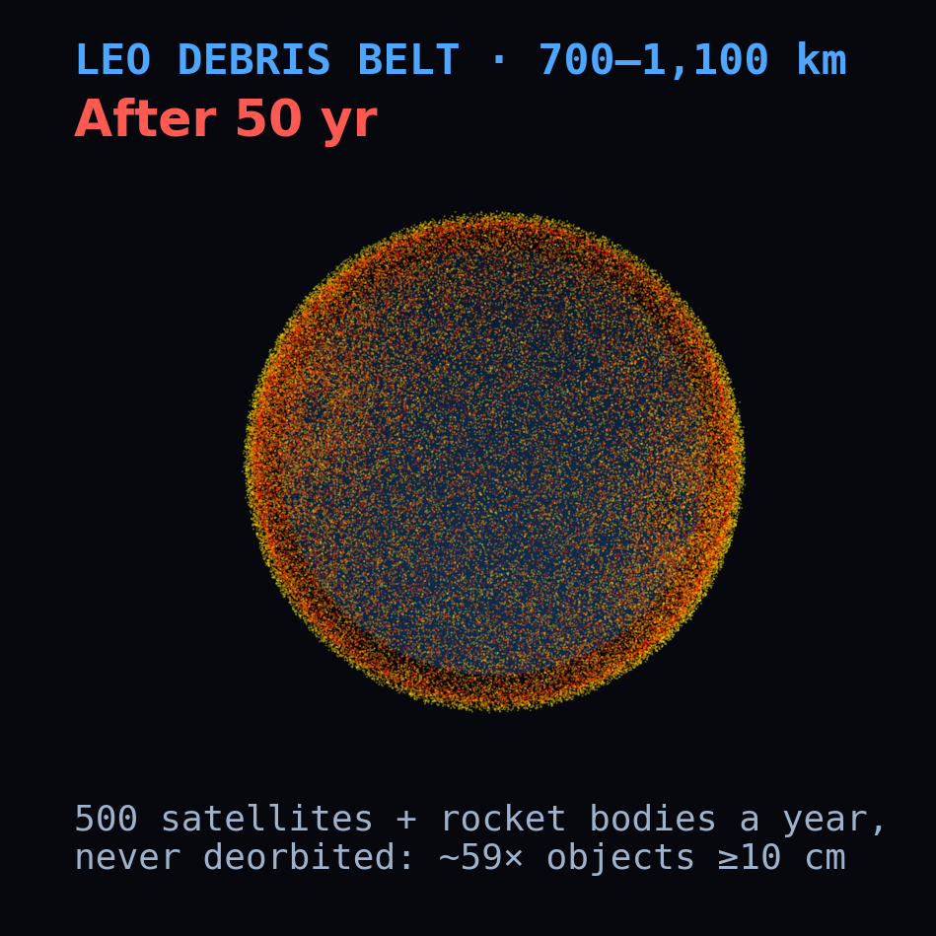
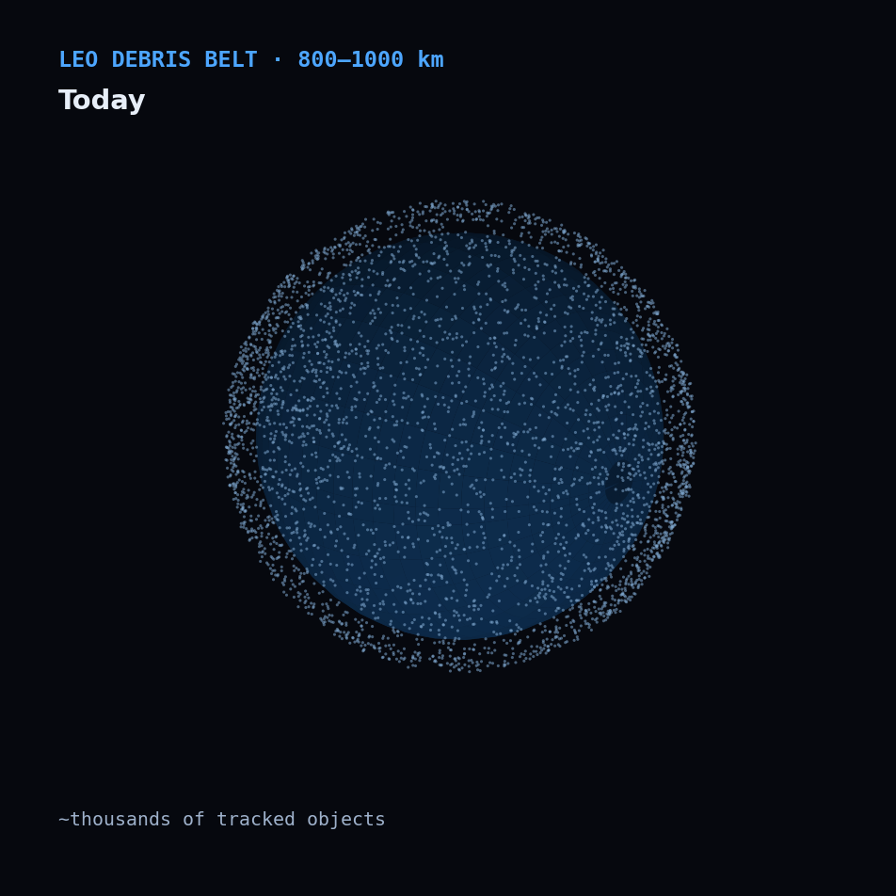
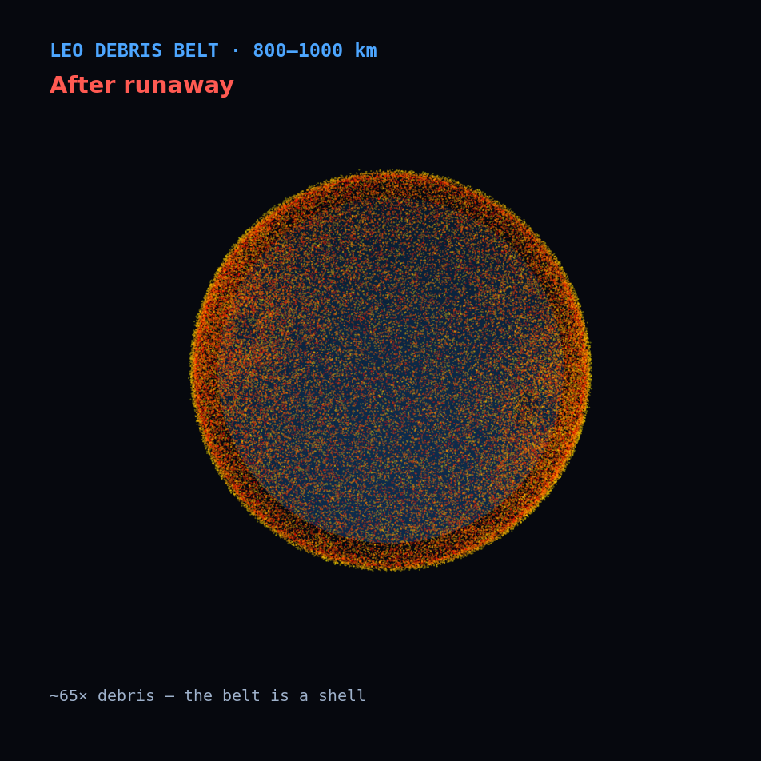
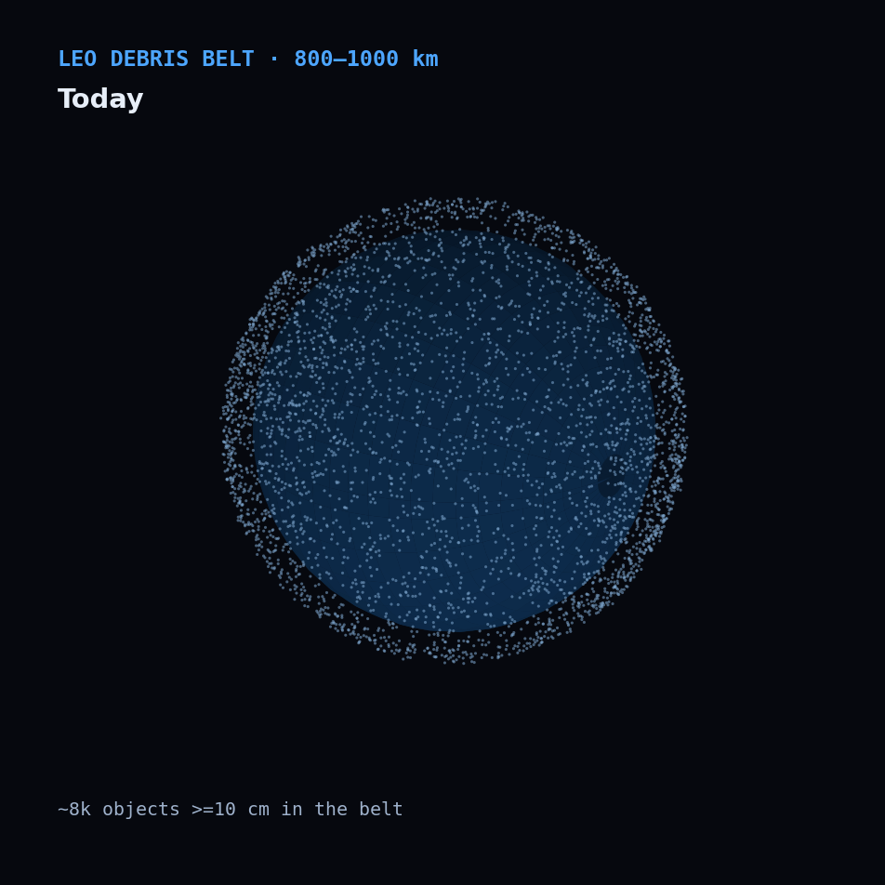
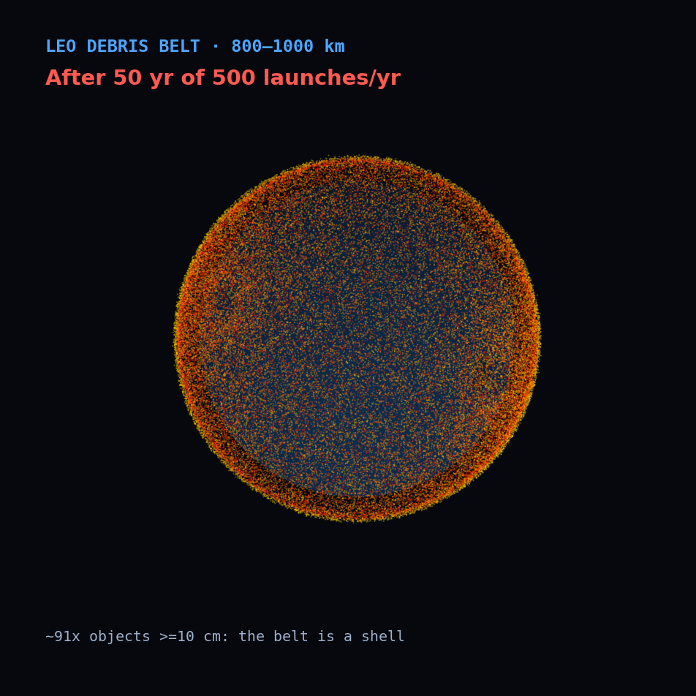
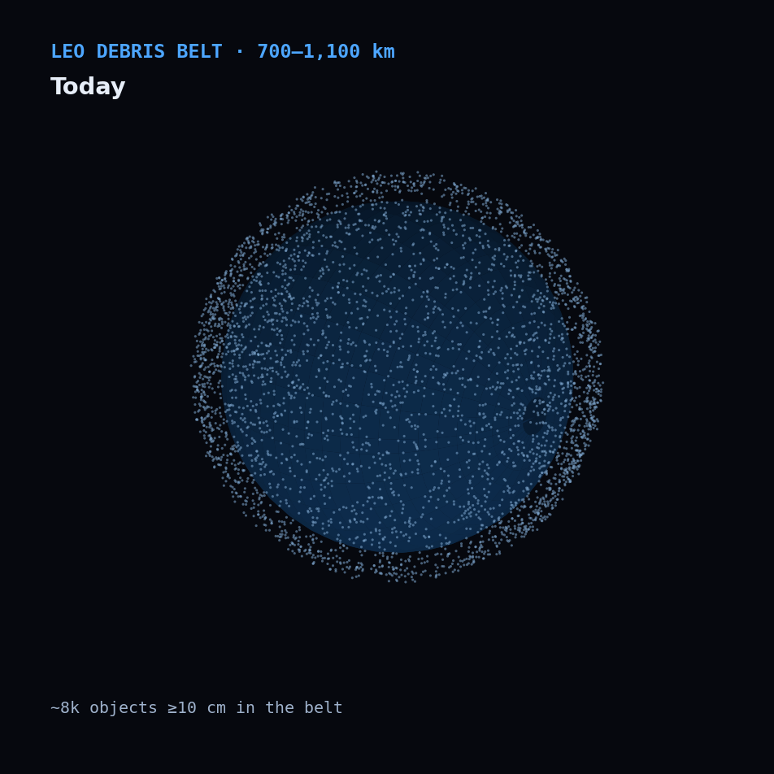



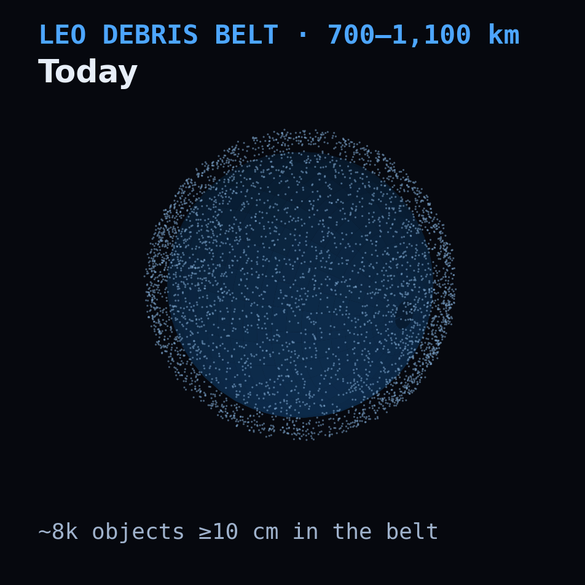
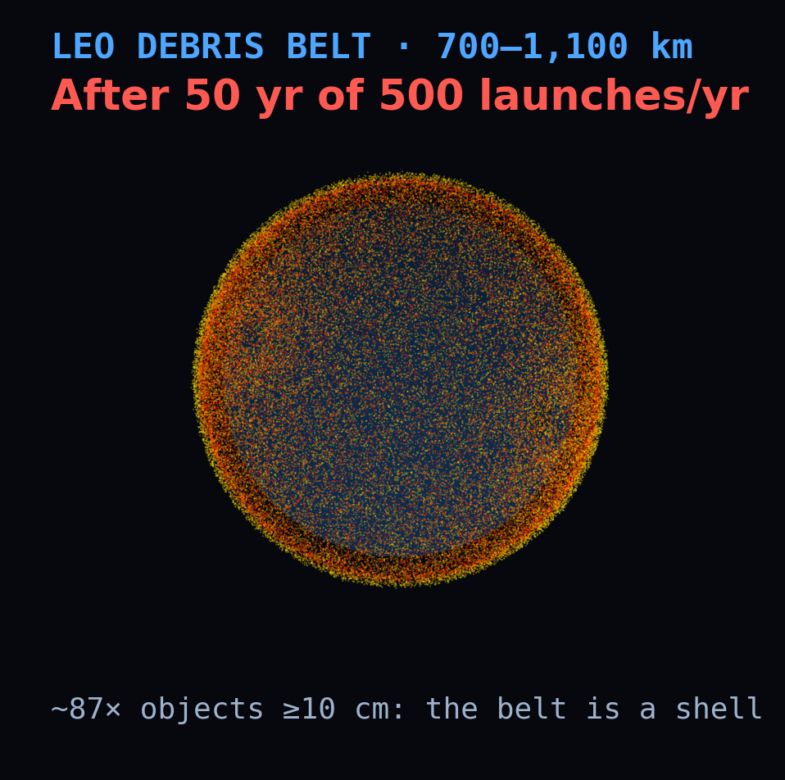
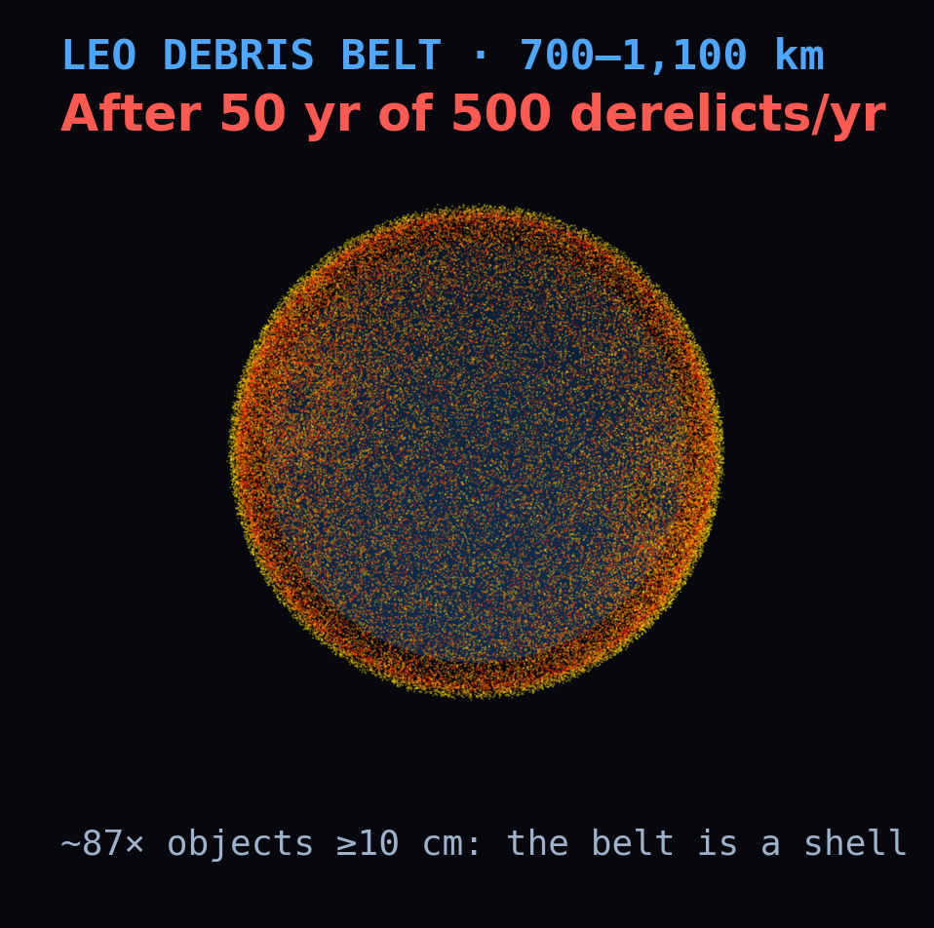


FOR COMPARISON · ORBIT VISUALIZATION
500 satellites and rocket bodies a year fill the belt
Injecting 500 satellites and rocket bodies a year into the 700–1,100 km belt, none ever deorbited, multiplies its ≥10 cm population ~59× in 50 years — from sparse (left) to a near-opaque hazard band (right). Illustrative; densities not to scale.

Slide 19






THE RECOVERABLE EXTREME
Low down, even a big breakup clears fast
Extra collision risk at 475 km after a 2.2 t breakup (like Cosmos-1408)
+16%
local collision risk at the peak — not a no-go zone
~1 yr
for drag to sweep it clean
Trigger: a large low-altitude fragmentation — an ASAT strike or a big collision.
The same debris at 900 km would linger for centuries. Low LEO forgives — the high belt does not.

Slide 20

CONGESTION & MEGA-CONSTELLATIONS
A present burden, a future hazard
Now — operational
Ahead — systemic
1,000,000+
satellites filed with regulators — SpaceX up to 1M, China ~200k, mostly on paper. The Kessler risk = scale × altitude × disposal compliance.
~16,800 active satellites (11,100 of them Starlink). Starlink alone made ~207,000 collision-avoidance manoeuvres in six months (Dec 2025 – May 2026) — and there is still no international traffic-management authority.
Same split as everything else: at 550 km the giant fleets self-clean — a burden. At 1,000–1,200 km that mass persists for centuries — the real systemic hazard.

Slide 21






FOR COMPARISON · WORKING SATELLITES
Satellites that deorbit: ×59 becomes ×4.6
Today's practice = most satellites deorbited, most conjunctions dodged.
Same traffic as the extreme case, but each satellite works for 5 years, holding its orbit and dodging tracked (≥10 cm) objects, and is then deorbited. Today's practice: 90% of satellites deorbited (the NASA/FCC/IADC benchmark; SpaceX reports over 99%), 80% of rocket bodies (ESA 2025), 90% of conjunctions avoided by the 89% that can manoeuvre (McDowell 2026). Nothing dodges 1–10 cm debris, and a hit there leaves a dead satellite. What remains comes mostly from failed disposals: at 500 a year, disposal alone gives ×5.4, avoidance alone ×53. Cube engine, 16 seeds (×3.6–×5.8); box model ×4.1.

Slide 22

THE REMEDY
Remove ~10 large dead objects a year and the belt holds flat
Remedy = remove the riskiest large dead objects, and make old stages safe.
Taking out the riskiest large objects each year — the heaviest, in the densest shells (NASA LEGEND's criterion) — bends the belt: ~10 a year holds its ≥10 cm population flat with nothing added, ~2 if old stages are also made safe so they can't explode (LEGEND: ~5). With 50 satellites and rocket bodies a year injected (never deorbited) it takes ~60. Cube engine, 16 seeds; cross-check at 10/yr: box ×0.99, discrete ×1.07. The belt isn't doomed; it's a maintenance problem.

Slide 23
THE VERDICT
A barrel of nails is a mission-kill weapon and a decades-long high-altitude nuisance — but it neither triggers Kessler nor ends LEO.
The barrel: it kills satellites, but even without limit it adds at most ~2,500 objects ≥10 cm to the belt (+25%).
What does: mass left in the 700–1,100 km belt without disposal. Deorbit 90% of satellites at end of life and even 500 a year grows the belt ×4.6, not ×59. Disposal reliability and removal decide the belt's fate.

Slide 24




HONEST ABOUT ITSELF
What the model can and can't say
Three engines agree
Main uncertainties
Not modelled
With nothing added, the belt's ≥10 cm population grows in all three: cube ×1.19 (16 seeds), box ×1.21, discrete ×1.21. Single cube runs span ×0.90–×1.56.
Disposal reliability sets the traffic outcome: at 500 a year, ×1.4 to ×18. Explosions set the no-launch baseline, ×1.02 to ×1.46. Cratering changes 1–10 cm results 2–3×, not the ≥10 cm belt.
Degradation debris; the solar cycle. Only the working-satellites slide has satellites that dodge and deorbit; elsewhere added objects stay dead. ~4 explosions a year. Order-of-magnitude only.
Checked against NASA: the 2006 benchmark
NASA's LEGEND study (Liou & Johnson 2006), rerun from the same 1 Jan 2006 catalog: no launches or explosions, 200 years, ≥10 cm objects only. LEGEND: 10.8 catastrophic collisions, ~60% at 900–1,000 km, LEO flat for ~50 years. Cube engine: 11.5 (5–17 over 16 seeds), ~45% there, +10% at 50 years; box model 9.9 and +15%. Removals: ~2 large objects a year hold the belt flat without explosions, ~10 with them (LEGEND: ~5).
CelesTrak + Space-Track · NASA breakup model · RTX 5090 / CUDA

Slide 25
SOURCES & REFERENCES
Data, models, and literature
Catalog data
Models & methods
Space-Track.org — full on-orbit GP catalog & SATCAT (RCS)
CelesTrak — GP / TLE catalog & SATCAT
NASA Standard Breakup Model — Johnson et al. (2001), Adv. Space Res.
Cube method / LEGEND — Liou (2003)
WGS-72 / J2
Krisko (2011), NASA ODQN 15(4) — implementing the breakup model
Foundational literature
Kessler & Cour-Palais (1978), J. Geophys. Res. — the debris belt
Liou & Johnson (2006), Science — growth without launches
Liou, Johnson & Hill (2010), Acta Astronautica — active removal
Liou (2011), Adv. Space Res. — removing ~5 objects a year
IADC comparison study (2013) — stability of future LEO
Events & policy
Fengyun-1C (2007), Cosmos–Iridium (2009), Cosmos-1408 (2021)
Outer Space Treaty (1967); PAROS / PPWT
McDowell, Jonathan's Space Report (active satellites, Sep 2026); Pultarova, Space.com (Jul 2026) — Starlink manoeuvres, from SpaceX's FCC filing
Charts are DebrisCascade model outputs on the live Space-Track catalog; orbit visualizations are illustrative. Values are order-of-magnitude estimates from a stylised model — not operational predictions.

